Slide 1


KIDS STORE
Nguyễn Hoàng Lê Minh - SE140733
Nguyễn Thành Tiến - SE161020
Bùi Hoàng Phúc - SE162053
Trần Thái Sơn - SE171846
Lê Nguyễn Đăng Khoa - SE173249

Slide 2
OVERVIEW
01
02
Product Overview
Actors
03
04
Functions
Main Flow

Slide 3
Product Overview
The Kid's Toy Store project aims to improve the online shopping experience for kid's toy and educational materials. This platform offers a variety of products that help enhance children's thinking and creative development. Integrating new technology helps create an easy-to-use interface, conveniently connecting customers with educational products and resources.

Slide 4
Actors
No | Actor | Description
1 | Administrator | Administrator will be responsible for managing the account list and customer information on the website.
2 | Staff | Staff will operate and manage the daily operations of the website. Key tasks include product management such as updating products and adding categories, tracking performance ensuring the growth and success of the website selling children's toys
3 | Customer | Customers will be able to search for products, add to cart, check out, provide product feedback, reviews, and interact with customer service when necessary.
4 | Guest | They will participate in activities on the website such as searching for products, filtering products and buying, selling and paying for the products they need.

Slide 5


Guest
Register/Login
Viewing Store

Slide 6



Customer
Buying Items
Viewing Your Order
Warranty

Slide 7


Staff
Managing Warranties
View Products
Managing Products

Slide 8


Admin
Managing Accounts
Revenue
Approving Products/Categories

Slide 9
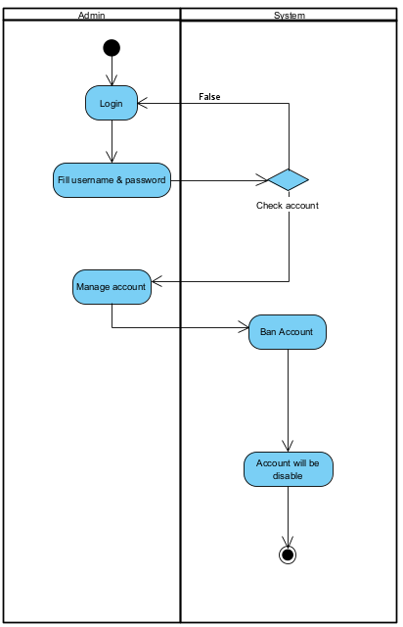
Main Flow - Admin - Ban Account

Slide 10
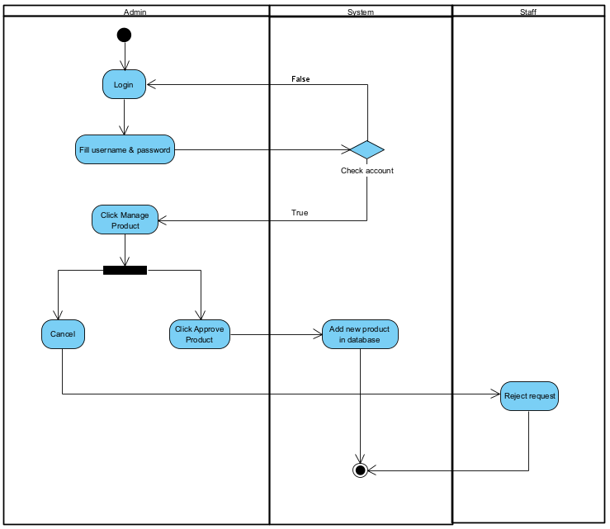
Main Flow - Admin - Product Request

Slide 11
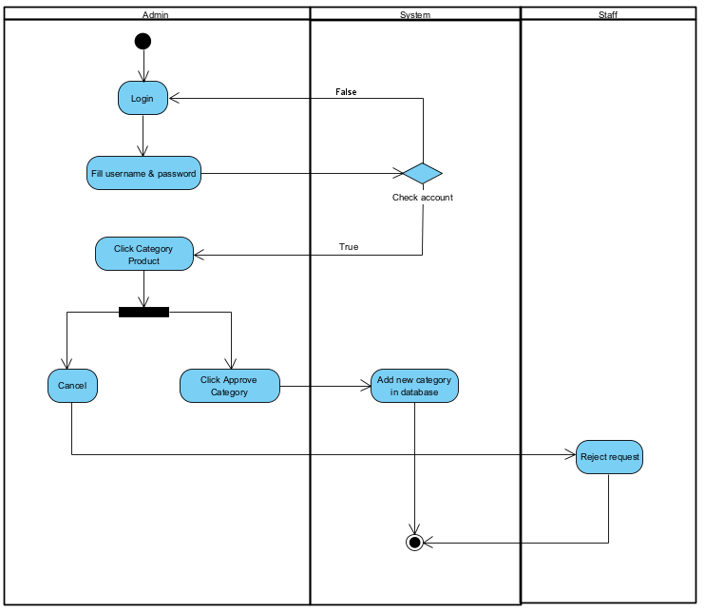
Main Flow - Admin - Category Request

Slide 12
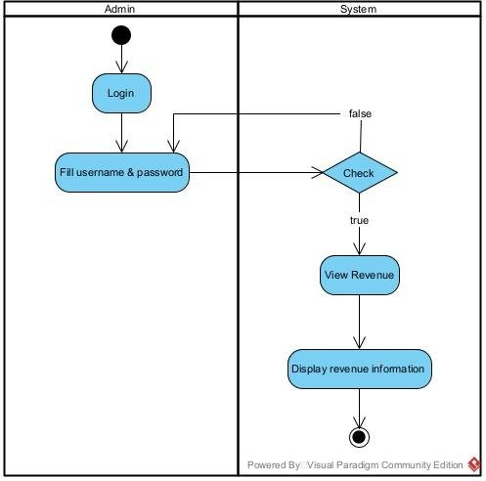
Main Flow - Admin - View Revenue

Slide 13
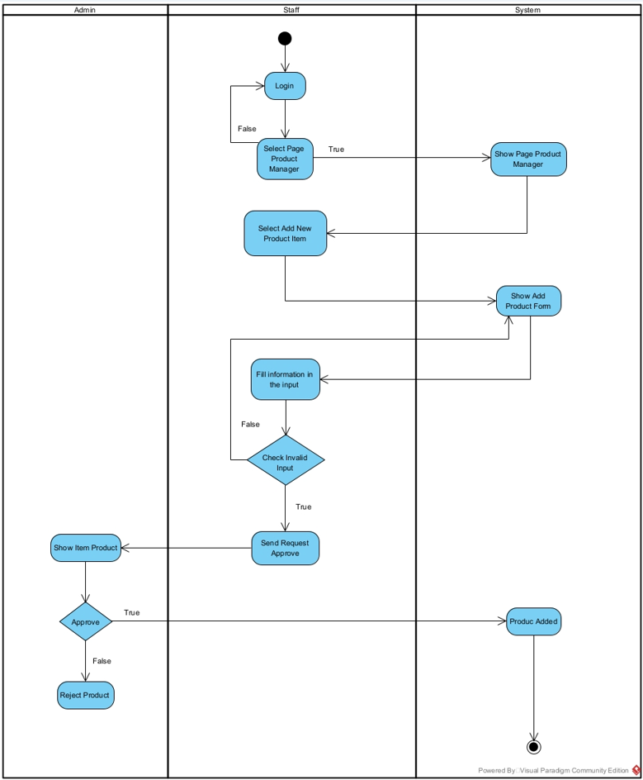
Main Flow - Staff Add Product

Slide 14
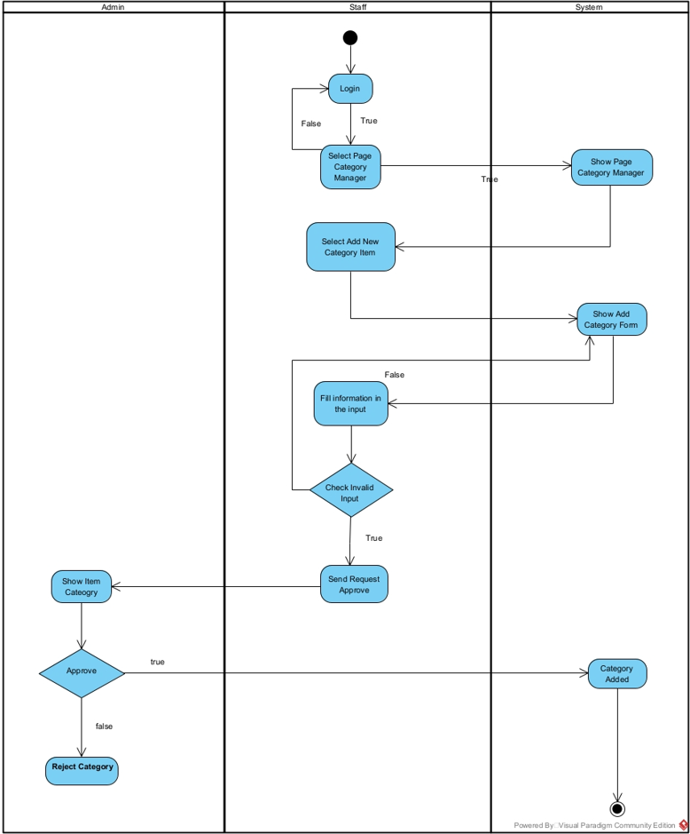
Main Flow - Staff Add Category

Slide 15
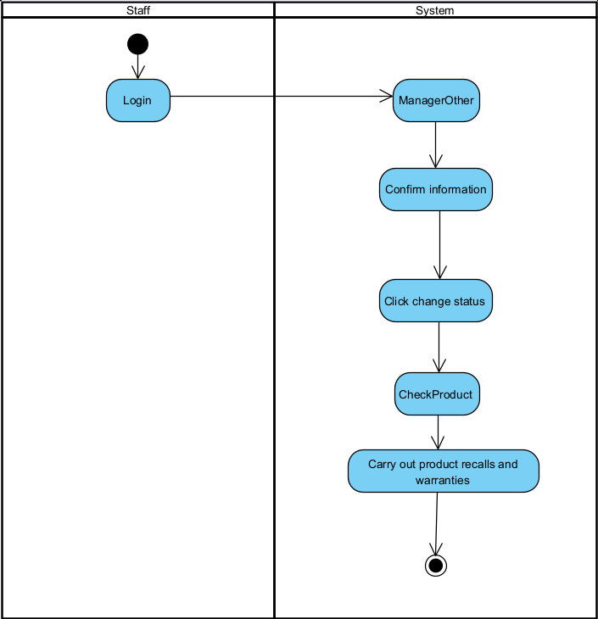
Main Flow - Staff Warranty

Slide 16
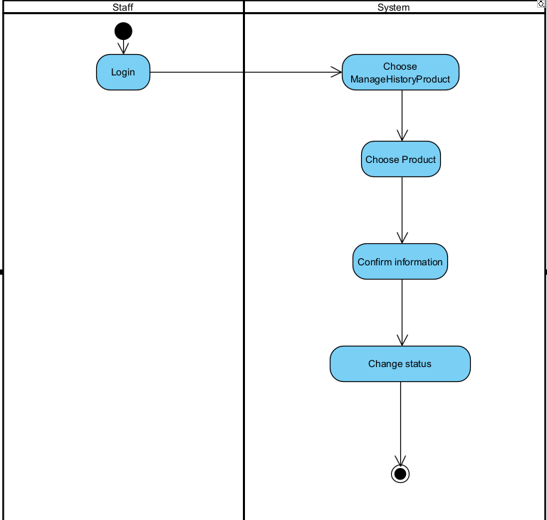
Main Flow - Staff - Request to purchase the products

Slide 17
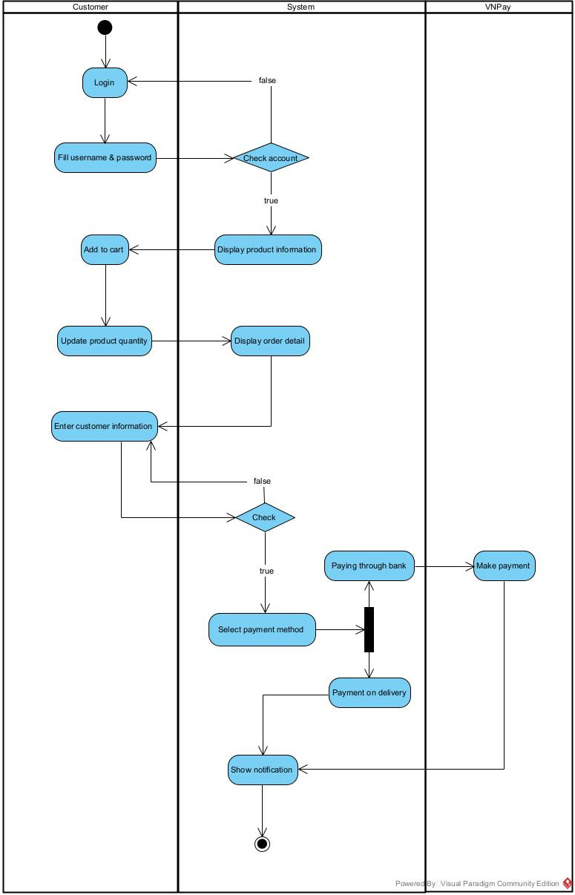
Main Flow - Customer Buy Product

Slide 18
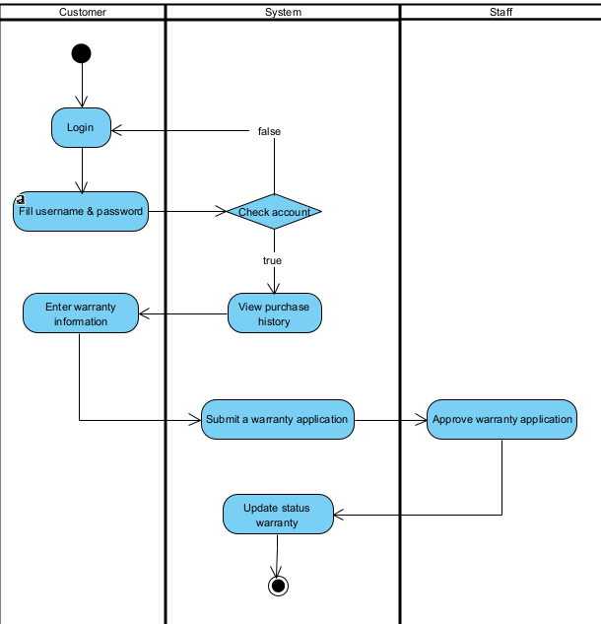
Main Flow - Customer Warranty

Slide 19
THANK YOU
For Your Attention

